Slide 1
Chapter 25: Secure Network Access Control
Instructor Materials
CCNP Enterprise: Core Networking

Slide 2
Chapter 25 Content
This chapter covers the following content:
Network Security Design for Threat Defense - This section describes a Cisco security framework to protect networks from evolving cybersecurity threats.
Next-Generation Endpoint Security - This section describes security components such as next-generation firewalls, Web Security Appliance (WSA), and Email Security Appliance (ESA) that are part of the Cisco security framework to protect endpoints from threats and attacks.
Network Access Control (NAC) -This section describes technologies such as 802.1x, Web Authentication (WebAuth), MAC Authentication Bypass (MAB), TrustSec and MACsec to enforce network access control.

Slide 3
Network Security Design for Threat Defense
Endpoints are extremely vulnerable to security threats, and they can become infected. A solid network security design protects the endpoints from these types of security threats and enforces endpoint network access.
This chapter describes the components of network security design for a campus environment that are used to protect, detect, and remediate security threats and attacks.

Slide 4
Network Security Design for Threat Defense Cisco SAFE
To address the evolving cybersecurity threats, Cisco created Cisco SAFE, a security architectural framework that helps design secure solutions for the following places in the network (PINs):
Branch
Campus
Data Center
Edge
Cloud
Wide Area Network (WAN)
Cisco SAFE focuses on the integration of security services within each of the PINs. For information on the underlying networking design and infrastructure see the Cisco Validated Design (CVD) guides, which provide detailed networking design and implementation guidance. CVDs can be found at www.cisco.com/go/cvd.

Slide 5
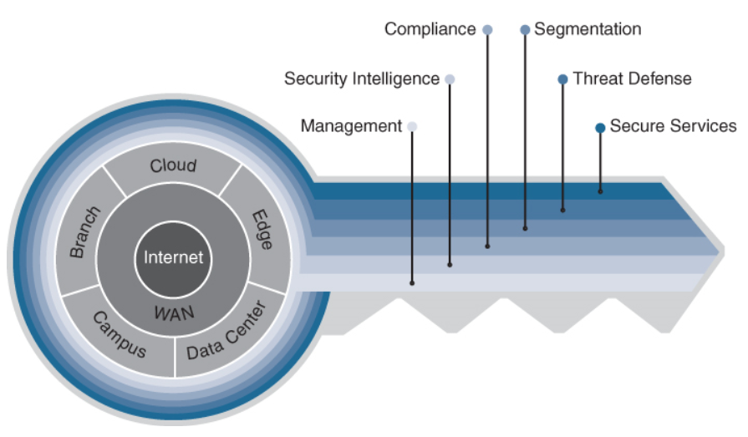
Network Security Design for Threat Defense Cisco SAFE Domains
Cisco SAFE also defines secure domains, which are operational areas used to protect the different PINs. The following security concepts are used to evaluate each PIN:
Management
Security Intelligence
Compliance
Segmentation
Threat Defense
Secure Services
Figure 25-1 The Key to Cisco SAFE

Slide 6
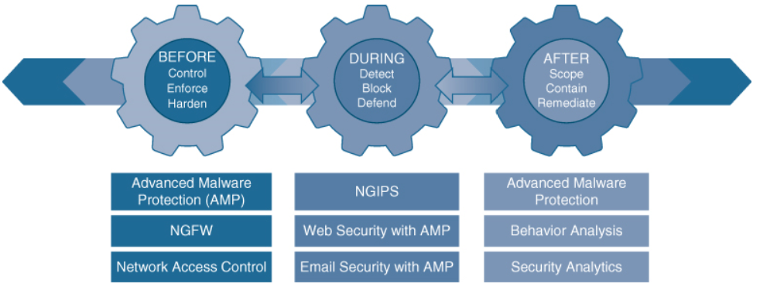
Network Security Design for Threat Defense Cisco SAFE Implementation
Implementing the Cisco SAFE framework in an organization provides advanced threat defense protection that spans the full attack continuum before, during, and after an attack for all the PINs:
Before
During
After
Figure 25-2 Cisco Products and Solutions
Across the Attack Continuum

Slide 7
Next-Generation Endpoint Security
To be able to detect the rapidly evolving threats, organizations should design their networks using a security framework such as that provided by Cisco SAFE.
The following sections describe the most critical components needed to implement the Cisco SAFE framework for a campus environment (or PIN, in Cisco SAFE terminology).

Slide 8
Next Generation Endpoint Security Cisco Talos
Talos is the Cisco threat intelligence organization, an elite team of security experts who are supported by sophisticated security systems to create threat intelligence that detects, analyzes, and protects against both known and emerging threats for Cisco products.
Cisco Talos was created from the combination of three security research teams:
IronPort Security Applications (SecApps)
The Sourcefire Vulnerability Research Team (VRT)
The Cisco Threat Research, Analysis, and Communications (TRAC) team
Talos receives valuable intelligence that
no other cybersecurity research team can match through the following intelligence feeds:
Advanced Microsoft and industry disclosures The Advanced Malware Protection (AMP) community
ClamAV, Snort, Immunet, SpamCop, SenderBase, Threat Grid, and Talos user communities
Honeypots
The Sourcefire Awareness, Education, Guidance, and Intelligence Sharing (AEGIS) program
Private and public threat feeds
Dynamic analysis

Slide 9
Next Generation Endpoint Security Cisco Threat Grid
Cisco Threat Grid is a solution that can perform static file analysis, as well as dynamic file analysis (also known as behavioral analysis), by running the files in a controlled and monitored sandbox environment.
Behavioral analysis is combined with threat intelligence feeds from Talos, as well as with existing security technologies to protect against known and unknown attacks.
It is also possible to upload suspicious files into a sandbox environment called Glovebox to safely interact with them and observe malware behavior directly.
Threat Grid is available as an appliance and in the cloud, and it is also integrated into existing Cisco security products and third-party solutions.
Automatic submission of suspicious files and samples is available for products and
solutions integrated with Threat Grid. When automatic submission is not available, files can
also be uploaded manually into Threat Grid for analysis.

Slide 10
Next Generation Endpoint Security Cisco Advanced Malware Protection (AMP)
Cisco Advanced Malware Protection (AMP) (formerly FireAMP) is a malware analysis and protection solution that goes beyond point-in-time detection.
Cisco AMP provides comprehensive protection for organizations across the full attack
continuum:
Attack Time | AMP Processes
Before | Global threat intelligence from Cisco Talos and Cisco Threat Grid feeds into AMP to protect against known and new emerging threats.
During | File reputation to determine whether a file is clean or malicious as well as sandboxing are used to identify threats during an attack.
After | Cisco AMP provides retrospection, indicators of compromise (IoCs), breach detection, tracking, analysis, and surgical remediation after an attack, when advanced malware has slipped past other defenses.

Slide 11
Next Generation Endpoint Security Cisco AMP Components
The architecture of AMP can be broken down into the following components:
AMP Cloud (private or public)
AMP connectors
AMP for Endpoints (Microsoft Windows, macOS X, Google Android, Apple iOS, and Linux)
AMP for Networks (NGFW, NGIPS, ISRs)
AMP for Email (ESA)
AMP for Web (WSA)
AMP for Meraki MX
Threat intelligence from Cisco Talos and Cisco Threat Grid
Cisco AMP for Endpoints on Apple iOS is known as the Cisco Security Connector (CSC). The CSC incorporates AMP for Endpoints and Cisco Umbrella.

Slide 12
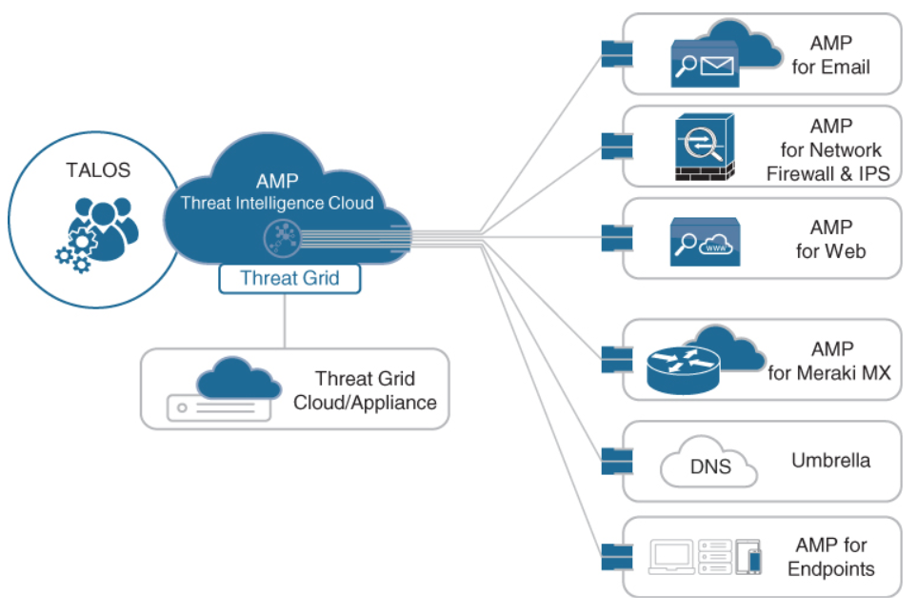
Next Generation Endpoint Security Cisco AMP Components (Cont.)
Figure 25-3 illustrates how all the AMP components come together to form the AMP
architecture.
Figure 25-3 AMP Components

Slide 13
Next Generation Endpoint Security Cisco AnyConnect
Cisco AnyConnect Secure Mobility Client is a modular endpoint software product
that is not only a VPN client that provides VPN access through Transport Layer Security (TLS)/Secure Sockets Layer (SSL) and IPsec IKEv2 but also offers enhanced security through various built-in modules, such as a VPN Posture (HostScan) module and an ISE Posture module.
Cisco AnyConnect also includes web security through Cisco Cloud Web Security, network visibility into endpoint flows within Stealthwatch, and roaming protection with Cisco Umbrella.
AnyConnect is supported across the following platforms:
Windows, macOS, iOS, Linux, Android, Windows Phone/Mobile, BlackBerry, and ChromeOS.
TLS/SSL is often used to indicate that either protocol is being discussed. The SSL protocol has been deprecated by the IETF in favor of the more secure TLS protocol, so TLS/SSL can be interpreted as referring to TLS only.

Slide 14
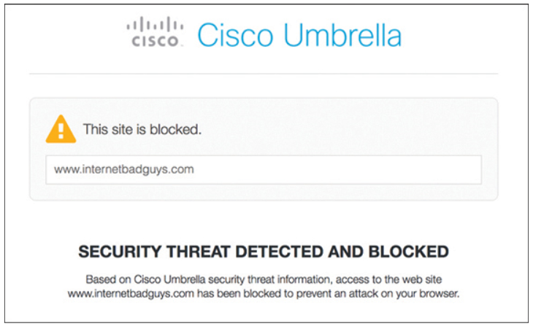
Next Generation Endpoint Security Cisco Umbrella
Cisco Umbrella (formerly known as OpenDNS) provides the first line of defense against threats on the internet by blocking requests to malicious internet destinations (domains, IPs, URLs) using the Domain Name System (DNS) before an IP connection is established or a file is downloaded.
It is 100% cloud delivered, with no hardware to install or software to maintain.
The Umbrella global network includes 30 data centers around the world using Anycast DNS, which allows it to guarantee 100% uptime.
Figure 25-4 Cisco Umbrella Blocking Phishing
Website

Slide 15
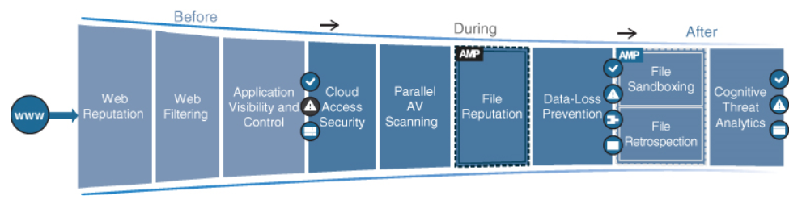
Next Generation Endpoint Security Cisco Web Security Appliance (WSA)
The Cisco Web Security Appliance (WSA) is an all-in-one web gateway that includes a wide variety of protections that can block hidden malware from both suspicious and legitimate websites.
Figure 25-5 WSA Capabilities
Across the Attack Continuum
Before | During | After
Web reputation filters Web filtering Cisco Application Visibility and Control (AVC) | Cloud access security Parallel antivirus (AV) scanning Layer 4 traffic monitoring File reputation and analysis with Cisco AMP Data loss prevention (DLP) | Continuously inspects for instances of undetected malware and breaches. Global Threat Analytics (GTA)

Slide 16
Next Generation Endpoint Security Before an Attack
Before an attack, the WSA actively detects and blocks potential threats before they happen
by applying web reputation filters and URL filtering and by controlling web application usage:
Terms | Description
Web reputation filters | Cisco WSA detects and correlates threats in real time using Talos. Web reputation filtering prevents client devices from accessing dangerous websites containing malware or phishing links.
Web filtering | Traditional URL filtering is combined with real-time dynamic content analysis. This is used to shut down access to websites known to host malware.
Cisco Application Visibility and Control (AVC) | Cisco AVC identifies and classifies the most relevant and widely used web and mobile applications and more than 150,000 micro-applications.

Slide 17
Next Generation Endpoint Security During an Attack
During an attack, the WSA uses security intelligence from cloud access security broker (CASB) providers, Talos, and AMP for networks to identify and block zero-day threats that managed to infiltrate the network:
Terms | Description
Cloud access security | WSA can protect against hidden threats in cloud apps
Parallel antivirus (AV) scanning | WSA enhances malware defense coverage with multiple anti-malware scanning engines
Layer 4 traffic monitoring | WSA scans all traffic, ports, and protocols to detect and block spyware “phone-home” communications
File reputation and analysis with Cisco AMP | WSA assesses files using the latest threat information from Cisco Talos
Data loss prevention (DLP) | WSA uses Internet Control Adaptation Protocol (ICAP) to integrate with DLP solutions from leading third-party DLP vendors

Slide 18
Next Generation Endpoint Security After an Attack
After an attack, Cisco WSA inspects the network continuously for instances of undetected malware and breaches.
After an initial detection, using Cisco AMP retrospection capabilities, Cisco WSA continues to scan files over an extended period of time, using the latest threat intelligence from Talos and AMP Thread Grid.
Alerts are sent when a file disposition changes to provide awareness and visibility into malware that evades initial defenses.
Global Threat Analytics (GTA), formerly Cognitive Threat Analytics (CTA), analyzes web traffic, endpoint data from Cisco AMP for Endpoints, and network data from Cisco Stealthwatch
Enterprise. It then identifies malicious activity before it can exfiltrate sensitive data.
WSA can be deployed in the cloud, as a virtual appliance, on-premises, or in a hybrid
arrangement. All features are available across any deployment option.

Slide 19
Next Generation Endpoint Security Cisco Email Security Appliance (ESA)
The Cisco Email Security Appliance (ESA) enables users to communicate securely via email and helps organizations combat email security threats with a multilayered approach.
Cisco ESA includes the following advanced threat protection capabilities that allow it to detect, block, and remediate threats across the attack continuum:
Global threat intelligence - It leverages real-time threat intelligence from Talos and AMP.
Reputation filtering - ESA blocks unwanted email with reputation filtering.
Spam protection - ESA uses the Cisco Context Adaptive Scanning Engine (CASE) to block spam emails.
Forged email detection - Forged email detection protects high-value targets such as executives against business email compromise (BEC) attacks.

Slide 20
Next Generation Endpoint Security Cisco Email Security Appliance (ESA) (Cont.)
Cisco Advanced Phishing Protection (CAPP) - CAPP combines Cisco Talos with local email intelligence and advanced machine learning techniques to model trusted email behaviors.
Cisco Domain Protection (CDP) - CDP for external email helps prevent phishing emails from being sent using a customer domains.
Malware defense - ESA protects against malware with Cisco AMP for email.
Graymail detection and Safe Unsubscribe - ESA detects and classifies graymail for an administrator to take action on it if necessary. Graymail consists of marketing, social networking, and bulk messages (that is, mailing list emails).
URL-related protection and control - ESA protects against malicious URLs with URL filtering and scanning of URLs in attachments and shortened URLs.

Slide 21
Next Generation Endpoint Security Cisco Email Security Appliance (ESA) (Cont.)
Outbreak filters - Outbreak filters defend against emerging threats and blended attacks by leveraging Cisco Talos.
Web interaction tracking - ESA generates reports that track the end users who click on URLs that have been rewritten by the outbreak filters. The reports include the following information:
Top users who clicked on malicious URLs
The top malicious URLs clicked by end users
Date and time, rewrite reason, and action taken on the URLs
Data security for sensitive content in outgoing emails - Confidential outbound messages that match one of the more than 100 expert policies included with ESA are automatically protected.

Slide 22
Next Generation Endpoint Security Next-Generation Intrusion Prevention System (NGIPS)
A system that passively monitors and analyzes network traffic for potential network intrusion attacks and logs the intrusion attack data for security analysis is known as an intrusion detection system (IDS). A system that provides IDS functions and also automatically blocks intrusion attacks is known as an intrusion prevention system (IPS).
A next-generation IPS (NGIPS) should include IPS functionality as well as the following capabilities:
Real-time contextual awareness
Advanced threat protection
Intelligent security automation
Unparalleled performance and scalability
Application visibility and control (AVC) and URL filtering

Slide 23
Next Generation Endpoint Security Next-Generation Intrusion Prevention System (Cont.)
With the acquisition of Sourcefire in 2013, Cisco added the Firepower NGIPS to its portfolio.
Following are some of the most important capabilities included with the Cisco Firepower NGIPS:
Features | Advanced Features
Real-time contextual awareness | Centralized management
Advanced threat protection and remediation | Global threat intelligence from the Cisco Talos
Intelligent security automation | Snort IPS detection engine
Unparalleled performance and scalability | High availability and clustering
AVC | Third-party and open-source ecosystem
URL filtering | Integration with Cisco ISE: Quarantine, Unquarantine, Shutdown

Slide 24
Next Generation Endpoint Security Next-Generation Firewall (NGFW)
A firewall is a network security device that monitors incoming and outgoing network traffic and allows or blocks traffic by performing simple packet filtering and stateful inspection based on ports and protocols.
A next-generation firewall (NGFW) can block threats such as advanced malware and application-layer attacks. A NGFW firewall must include:
Standard firewall capabilities such as stateful inspection
An integrated IPS
Application-level inspection (to block malicious or risky apps)
The ability to leverage external security intelligence to address evolving security threats

Slide 25
Next Generation Endpoint Security NGFW: Management Options
The following management options are available for NGFWs:
For FTD or Firepower Services software:
Firepower Management Center (FMC)
Firepower Device Manager (FDM) for small appliances
For ASA software:
The command-line interface (CLI)
Cisco Security Manager (CSM)
Adaptive Security Device Manager (ASDM)
Cisco Defense Orchestrator
FTD or Firepower Services software CLI configuration is not supported. CLI is only available for initial setup and troubleshooting purposes.

Slide 26
Next Generation Endpoint Security Cisco Firepower Management Center (FMC)
The Cisco FMC is a centralized management platform that aggregates and correlates threat
events, contextual information, and network device performance data.
The FMC performs event and policy management for the following Firepower security
solutions:
Cisco Firepower NGFW and NGFWv
Cisco Firepower NGIPS and NGIPSv
Cisco Firepower Threat Defense for ISR
Cisco ASA with Firepower Services
Cisco Advanced Malware Protection (AMP)

Slide 27
Next Generation Endpoint Security Cisco Stealthwatch
Cisco Stealthwatch is a collector and aggregator of network telemetry data that performs network security analysis and monitoring to automatically detect threats that manage to infiltrate a network as well as the ones that originate from within a network.
There are currently two offerings available for Stealthwatch:
Stealthwatch Enterprise
Stealthwatch Cloud

Slide 28
Next Generation Endpoint Security Cisco Stealthwatch Enterprise
Stealthwatch Enterprise provides real-time visibility into activities occurring within the network.
At the core of Stealthwatch Enterprise are the Flow Rate License, the Flow Collector, Management Console, and Flow Sensor. Optional but recommended components include the following:
Cisco Stealthwatch Threat Intelligence
Cisco Stealthwatch Endpoint
Cisco Stealthwatch Cloud
Stealthwatch Enterprise offers the following benefits:
Real-time threat detection
Incident response and forensics
Network segmentation
Network performance and capacity planning
Ability to satisfy regulatory requirements

Slide 29
Next Generation Endpoint Security Cisco Stealthwatch Enterprise (Cont.)
Stealthwatch Enterprise requires the following components:
Flow Rate License - The Flow Rate License is required for the collection, management, and analysis of flow telemetry data and aggregates flows at the Stealthwatch Management Console, as well as to define the volume of flows that can be collected
Flow Collector - The Flow Collector collects and analyzes enterprise telemetry data and other types of flow data.
Stealthwatch Management Console (SMC) - The SMC is the control center that aggregates, organizes, and presents analysis from up to 25 Flow Collectors, Cisco ISE, and other sources.
Optional Stealthwatch Enterprise components include the following:
Flow Sensor
UDP Director

Slide 30
Next Generation Endpoint Security Cisco Stealthwatch Cloud
Stealthwatch Cloud provides the visibility and continuous threat detection required to secure the on-premises, hybrid, and multicloud environments.
Cisco Stealthwatch Cloud consists of two primary offerings:
Public Cloud Monitoring - Cisco Stealthwatch Cloud Public Cloud Monitoring provides visibility and threat detection in AWS, GCP, and Microsoft Azure cloud infrastructures. It is a SaaS-based solution that can be deployed easily and quickly.
Private Network Monitoring - Cisco Stealthwatch Cloud Private Network Monitoring provides visibility and threat detection for the on-premises network, delivered from a cloud-based SaaS solution.
Stealthwatch Cloud consumes metadata only. The actual packet payloads are never retained or transferred outside the network.

Slide 31
Next Generation Endpoint Security Cisco Identity Services Engine (ISE)
Cisco Identity Services Engine (ISE) is a security policy management platform that provides highly secure network access control (NAC) to users and devices across wired, wireless, and VPN connections.
Some of the most important features ISE include the following:
ISE Features
Streamlined network visibility | Streamlined device onboarding
Cisco Digital Network Architecture (DNA) Center integration | Internal certificate authority
Centralized secure network access control | Device profiling:
Centralized device access control | Endpoint posture service
Cisco TrustSec | Active Directory support
Guest lifecycle management | Cisco Platform Exchange Grid (pxGrid)

Slide 32
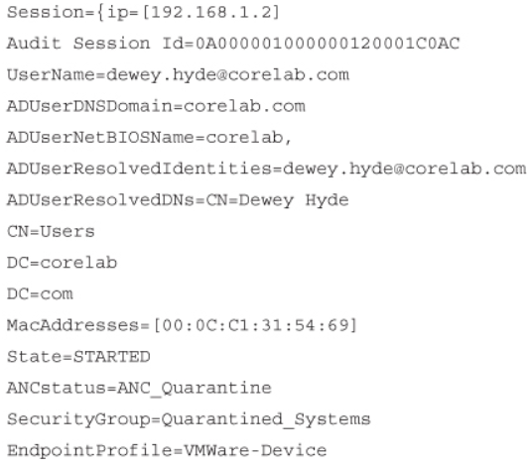
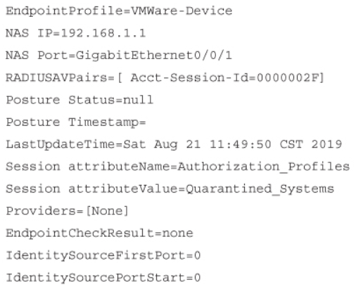
Next Generation Endpoint Security Cisco Identity Services Engine (ISE) Example
Example 25-1 shows the type of contextual information Cisco ISE can share with devices integrated with it through pxGrid.
Example 25-1 Contextual Information from Cisco ISE Session Directory

Slide 33
Network Access Control (NAC)
This section describes multiple network access control (NAC) technologies, such as 802.1x, MAC Authentication Bypass (MAB), and Web Authentication (WebAuth), as well as nextgeneration NAC technologies such as TrustSec and MACsec.

Slide 34
Network Access Control (NAC) 802.1x
IEEE 802.1x (referred to as Dot1x) is a standard for port-based network access control (PNAC) that provides an authentication mechanism for local area networks (LANs) and wireless local area networks (WLANs).
802.1x comprises the following components:
Extensible Authentication Protocol (EAP) - This message format and framework defined by RFC provides an encapsulated transport for authentication parameters.
EAP method (also referred to as EAP type) - Different authentication methods can be used with EAP.
EAP over LAN (EAPoL) - This Layer 2 encapsulation protocol is defined by 802.1x for the transport of EAP messages over IEEE 802 wired and wireless networks.
RADIUS protocol - This is the AAA protocol used by EAP.

Slide 35
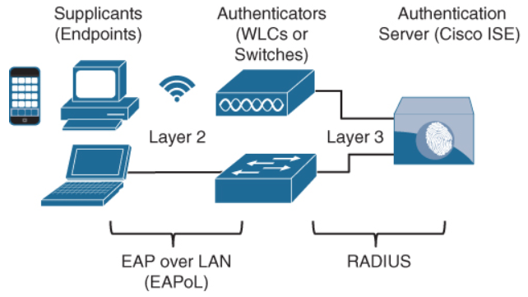
Network Access Control (NAC) 802.1x Roles
802.1x network devices have the following roles:
Supplicant - Software on the endpoint communicates and provides identity credentials through EAPoL with the authenticator.
Authenticator - A network access device (NAD) such as a switch or wireless LAN controller (WLC) controls access to the network based on the authentication status of the user or endpoint.
Authentication server - RADIUS server performs authentication of the client.
Figure 25-6 802.1x Roles and Components

Slide 36
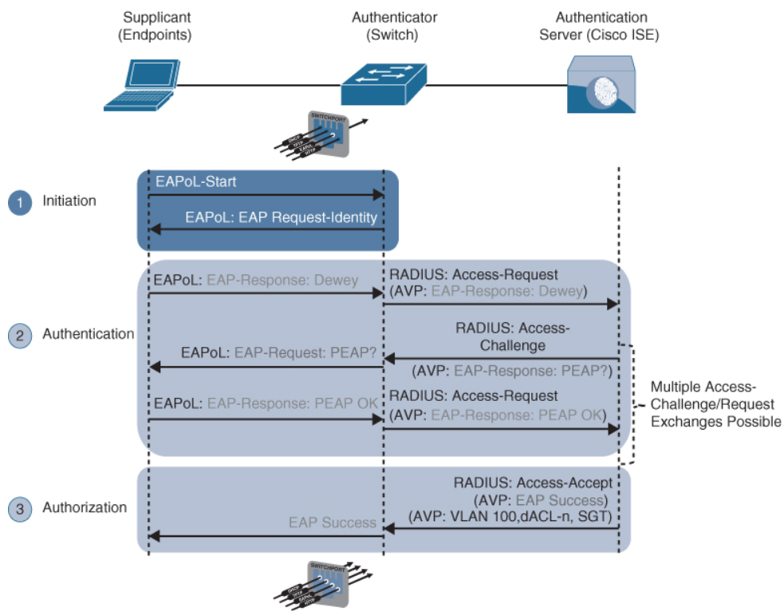
Network Access Control (NAC) 802.1x Authentication
The EAP identity exchange and authentication occur between the supplicant and the authentication server.
Step 1. When the authenticator notices a port coming up, it starts the authentication process by sending periodic EAP-request/identify frames.
Step 2. The authenticator relays EAP messages between the supplicant and the authentication server.
Step 3. If authentication is successful, the authentication server returns a RADIUS access-accept message.
Figure 25-7 Successful 802.1x Authentication Process Flow

Slide 37
Network Access Control (NAC) EAP Methods
There are many different EAP authentication methods available, most of them based on Transport Layer Security (TLS). The following are the most commonly used EAP methods, which are described in this section:
EAP challenge-based authentication method
Extensible Authentication Protocol-Message Digest 5 (EAP-MD5)
EAP TLS authentication method
Extensible Authentication Protocol-Transport Layer Security (EAP-TLS)
EAP tunneled TLS authentication methods
Extensible Authentication Protocol Flexible Authentication via Secure Tunneling (EAP-FAST)
Extensible Authentication Protocol Tunneled Transport Layer Security (EAP-TTLS)
Protected Extensible Authentication Protocol (PEAP)
EAP inner authentication methods
EAP Generic Token Card (EAP-GTC)
EAP Microsoft Challenge Handshake Authentication Protocol Version 2 (EAP-MSCHAPv2)
EAP TLS.

Slide 38
Network Access Control (NAC) EAP Methods (Cont.)
Following is a description of each of the EAP authentication methods:
EAP-MD5 – This uses the MD5 message-digest algorithm to hide the credentials in a hash.
EAP-TLS – This uses the TLS Public Key Infrastructure (PKI) certificate authentication mechanism to provide mutual authentication of supplicant to authentication server and authentication server to supplicant.
PEAP - In PEAP, only the authentication server requires a certificate. PEAP forms an encrypted TLS tunnel between the supplicant and the authentication server
After the tunnel has been established, PEAP uses one of the following EAP authentication inner methods to authenticate the supplicant through the outer PEAP TLS tunnel:
PEAP Authentication
EAP-MSCHAPv2 (PEAPv0) | EAP-TLS | EAP-TTLS
EAP-GTC (PEAPv1) | EAP-FAST

Slide 39
Network Access Control (NAC) EAP Chaining
EAP-FAST includes the option of EAP chaining:
Supports machine and user authentication inside a single outer TLS tunnel
Enables machine and user authentication to be combined into a single overall authentication result
Allows the assignment of greater privileges or posture assessments to users who connect to the network using corporate managed devices

Slide 40
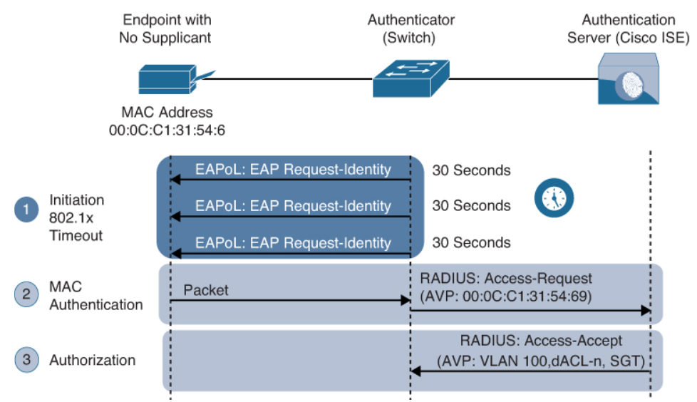
Network Access Control (NAC) MAC Authentication Bypass (MAB)
MAC Authentication Bypass (MAB) is an access control technique that enables port-based access control using the MAC address of an endpoint.
Step 1. The switch initiates authentication by sending an EAPoL identity request message to the endpoint every 30 seconds by default.
Step 2. The switch begins MAB by opening the port to accept a single packet from which it will learn the source MAC address of the endpoint.
Step 3. The RADIUS server determines whether the device should be granted access to the network
Figure 25-8 Successful MAB Authentication
Process Flow

Slide 41
Network Access Control (NAC) MAC Authentication Bypass (Cont.)
MAC addresses are easily spoofed. For this reason, MAB authenticated endpoints should be given very restricted access and should only be allowed to communicate to the networks and services that the endpoints are required to speak to.
If the authenticator is a Cisco switch, then many authorization options can be applied as part of the authorization result from the authentication server, including the following:
Downloadable ACLs (dACLs)
Dynamic VLAN assignment (dVLAN)
Security Group Tags (SGT) tags

Slide 42
Network Access Control (NAC) Web Authentication (WebAuth)
Web Authentication (WebAuth) can be used for endpoints that try to connect to the network might not have 802.1x supplicants and might not know the MAC address to perform MAB.
WebAuth, like MAB, can be used as a fallback authentication mechanism for 802.1x.
If both MAB and WebAuth are configured as fallbacks for 802.1x, when 802.1x times out a switch first attempts to authenticate through MAB, and if it fails, the switch attempts to authenticate with WebAuth.
Unlike MAB, WebAuth is only for users and not devices since it requires a web browser and manual username and password entry.
There are two types of WebAuth:
Local Web Authentication
Centralized Web Authentication with Cisco ISE

Slide 43
Network Access Control (NAC) Local Web Authentication
Local Web Authentication (LWA) is the first form of Web Authentication that was created.
The switch (or wireless controller) redirects web traffic (HTTP and/or HTTPS) to a locally hosted web portal running in the switch where an end user can enter a username and a password.
When the switch sends the login credentials on behalf of the user, it is considered to be LWA.
The LWA web portals are not customizable.
With Cisco switches, there is no native support for advanced services such as acceptable use policy (AUP), acceptance pages, password changing capabilities, device registration, and self-registration. For those advanced capabilities, a centralized web portal is required.
LWA does not support VLAN assignment; it supports only ACL assignment.
LWA doesn’t support the change of authorization (CoA) feature to apply new policies. Therefore, access policies cannot be changed based on posture or profiling state, and even administrative changes cannot be made as a result of malware to quarantine the endpoint.

Slide 44
Network Access Control (NAC) Central Web Authentication with Cisco ISE
Cisco created Centralized Web Authentication (CWA) to overcome LWA’s deficiencies.
CWA supports the following:
CoA for posture profiling, as well as dACL and VLAN authorization options.
All the advanced services: client provisioning, posture assessments, acceptable use policies, password changing, self-registration, and device registration.
Just like LWA, CWA is only for endpoints that have a web browser, where the user can manually enter a username and a password.
With CWA, WebAuth and guest VLAN functions remain mutually exclusive.

Slide 45
Network Access Control (NAC) Central Web Authentication with Cisco ISE (Cont.)
Authentication for CWA is different from authentication for LWA. The following steps detail how CWA authentication takes place:
Step 1. The endpoint entering the network does not have a configured supplicant or the supplicant is misconfigured.
Step 2. The switch performs MAB, sending the RADIUS access-request to Cisco ISE (the authentication server).
Step 3. The authentication server (ISE) sends the RADIUS result, including a URL redirection, to the centralized portal on the ISE server itself.
Step 4. The endpoint is assigned and IP address, DNS server, and default gateway using DHCP.
Step 5. The end user opens a browser and enters credentials into the centralized web portal.
Step 6. ISE sends a re-authentication change of authorization (CoA-reauth) to the switch.
Step 7. The switch sends a new MAB request with the same session ID to ISE. ISE sends the final authorization result to the switch for the end user.

Slide 46
Network Access Control (NAC) Enhanced Flexible Authentication (FlexAuth)
By default, a Cisco switch configured with 802.1x, MAB, and WebAuth always attempts 802.1x authentication first, followed by MAB, and finally WebAuth.
If an endpoint that does not support 802.1x tries to connect to the network, it needs to wait for a considerable amount of time before WebAuth is offered as an authentication option.
Enhanced FlexAuth (also referred to as Access Session Manager) addresses this problem by allowing multiple authentication methods concurrently (for example, 802.1x and MAB) so that endpoints can be authenticated and brought online more quickly.
Enhanced FlexAuth is a key component of the Cisco Identity-Based Networking Services (IBNS) 2.0 integrated solution, which offers authentication, access control, and user policy enforcement.

Slide 47
Network Access Control (NAC) Cisco Identity-Based Networking Services (IBNS) 2.0
Cisco IBNS 2.0 is an integrated solution that offers authentication, access control, and user policy enforcement with a common end-to-end access policy that applies to both wired and wireless networks.
It is a combination of the following existing features and products:
Enhanced FlexAuth (Access Session Manager)
Cisco Common Classification Policy Language (C3PL)
Cisco ISE

Slide 48
Network Access Control (NAC) Cisco TrustSec
TrustSec is a next-generation access control enforcement solution developed by Cisco to address the growing operational challenges related to maintaining firewall rules and ACLs by using Security Group Tag (SGT) tags.
TrustSec uses SGT tags to perform ingress tagging and egress filtering to enforce access control policy.
Cisco ISE assigns the SGT tags to users or devices that are successfully authenticated and authorized through 802.1x, MAB, or WebAuth.
The SGT tag assignment is delivered to the authenticator as an authorization option (in the same way as a dACL). After the SGT tag is assigned, an access enforcement policy (allow or drop) based on the SGT tag can be applied at any egress point of the TrustSec network.
SGT tags represent the context of the user, device, use case, or function. This means SGT tags are often named after particular roles or business use cases.
SGT tags are referred to as scalable group tags in Cisco Software-Defined Access (SD-Access).

Slide 49
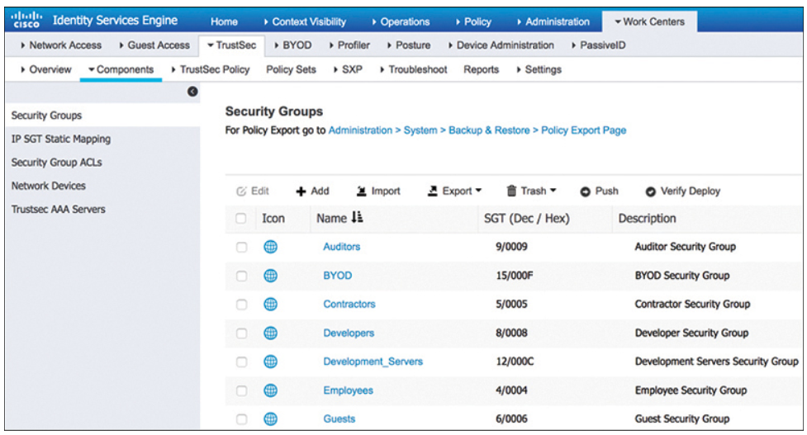
Network Access Control (NAC) Cisco TrustSec (Cont.)
Figure 25-9 illustrates a list of default SGT tags on Cisco ISE. The SGT tags all have business-relevant names and descriptions.
The SGT name is available on ISE and network devices to create policies; what is actually inserted into a Layer 2 frame SGT tag is a numeric value like the ones shown in the SGT column in decimal and hexadecimal notation.
TrustSec configuration occurs in three phases:
Ingress classification
Propagation
Egress enforcement
Figure 25-9 Default SGT Tags in Cisco ISE

Slide 50
Network Access Control (NAC) Ingress Classification
Ingress classification is the process of assigning SGT tags to users, endpoints, or other resources as they ingress the TrustSec network, and it can happen in one of two ways:
Dynamic assignment - The SGT is assigned dynamically and can be downloaded as an authorization option from ISE when authenticating using 802.1x, MAB, or WebAuth.
Static assignment - In environments such as a data center that do not require 802.1x, MAB, or WebAuth authentication, dynamic SGT assignment is not possible. Static assignment on a device can be one of the following:
IP to SGT tag
Subnet to SGT tag
VLAN to SGT tag
Layer 2 interface to SGT tag
Layer 3 logical interface to SGT tag
Port to SGT tag
Port profile to SGT tag
As an alternative to assigning an SGT tag to a port, Cisco ISE added the ability to centrally configure a database of IP addresses and their corresponding SGT tags. Network devices that are SGT capable can download the list from Cisco ISE.

Slide 51
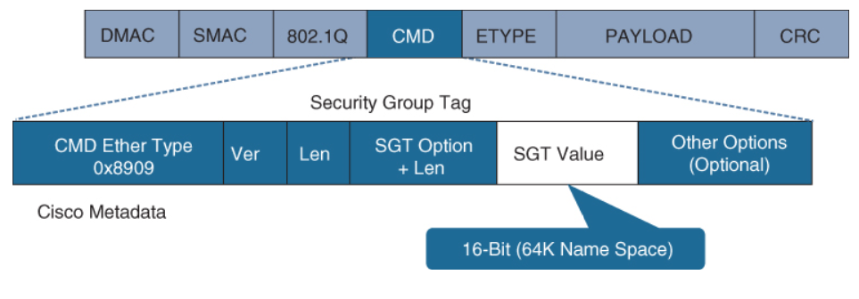
Network Access Control (NAC) Propagation
Propagation is the process of communicating the mappings to the TrustSec network devices that will enforce policy based on SGT tags.
There are two methods available for propagating an SGT tag—inline tagging (also referred to as native tagging) and the Cisco-created protocol SGT Exchange Protocol (SXP):
Inline tagging - With inline tagging, a switch inserts the SGT tag inside a frame to allow upstream devices to read and apply policy.
Figure 25-10 Layer 2 Ethernet Frame with an SGT Tag

Slide 52
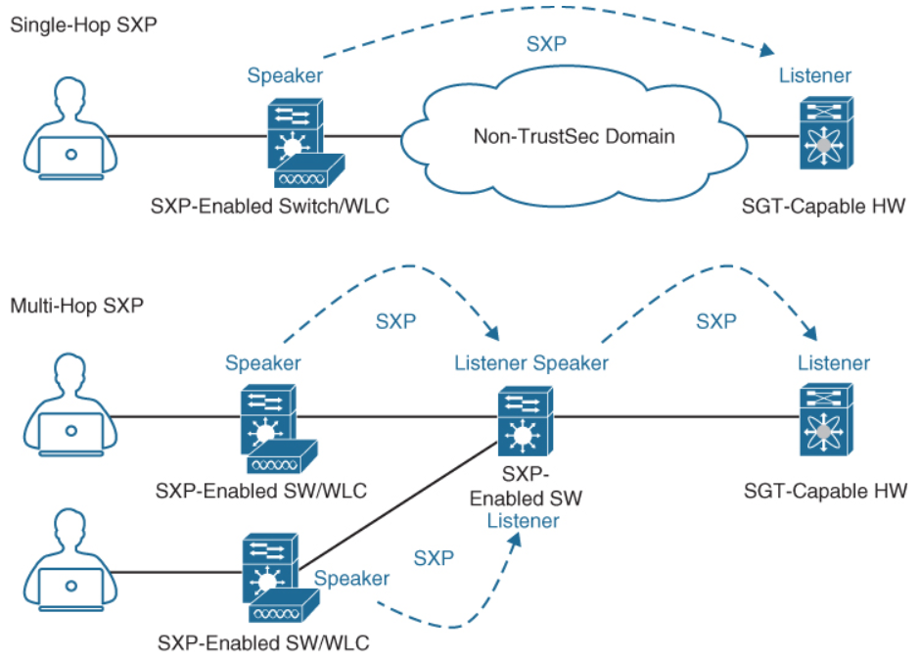
Network Access Control (NAC) Propagation (Cont.)
SXP propagation - SXP is a TCP-based peer-to-peer protocol used for network devices that do not support SGT inline tagging in hardware.
Non-inline tagging switches also have an SGT mapping database to check packets against and enforce policy.
The SXP peer that sends IP-to-SGT bindings is called a speaker.
The IP-to-SGT binding receiver is called a listener.
SXP connections can be single-hop or multi-hop, as shown in Figure 25-11.
Figure 25-11 Single-Hop and Multi-Hop
SXP Connections

Slide 53
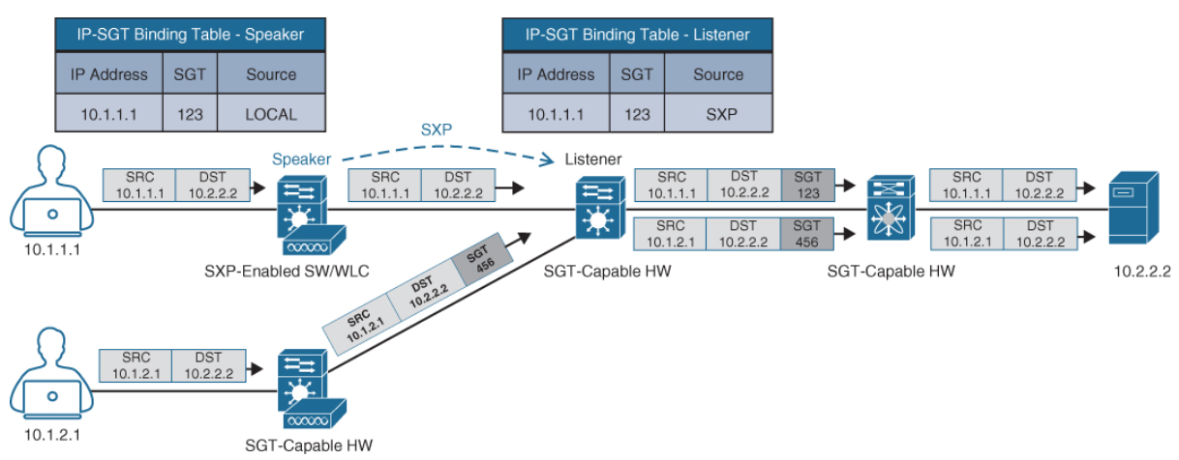
Network Access Control (NAC) Propagation: SPX Example
Figure 25-12 shows an example of one access switch that supports native tagging. The packets get tagged on the uplink port and through the infrastructure.
It also shows a switch that is not capable of inline tagging and that uses SXP to update the upstream switch.
In both cases, the upstream switch continues to tag the traffic throughout the infrastructure.
Figure 25-12 Inline Tagging
and SXP Propagation

Slide 54
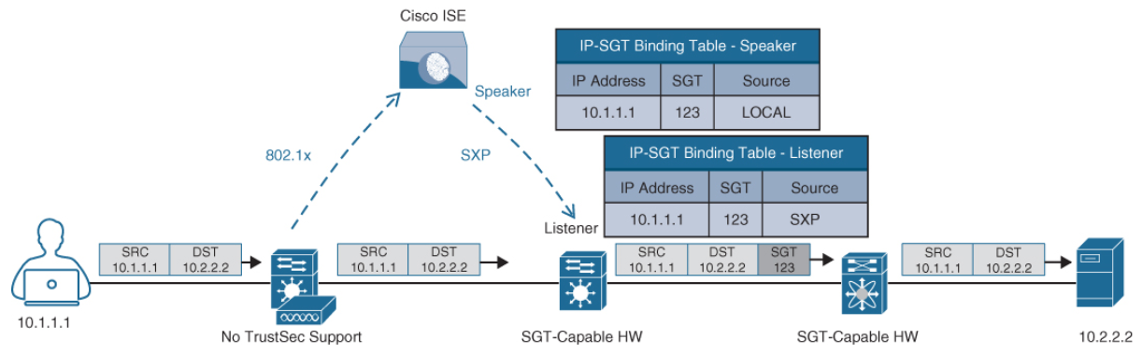
Network Access Control (NAC) Propagation: SPX Peering
Figure 25-13 illustrates an example where a user authenticates to ISE via 802.1x.
The user is connected to a switch that does not support inline tagging or SXP. This means an SGT-to-IP binding cannot be assigned to the user on the switch. The solution is for ISE to assign an SGT to the user by sending a mapping through SXP to an upstream device that supports TrustSec.
Cisco ISE also supports assigning the SGT mapping information to an upstream device through pxGrid.
Figure 25-13 SXP Peering Between Cisco ISE and TrustSec-Capable Devices

Slide 55
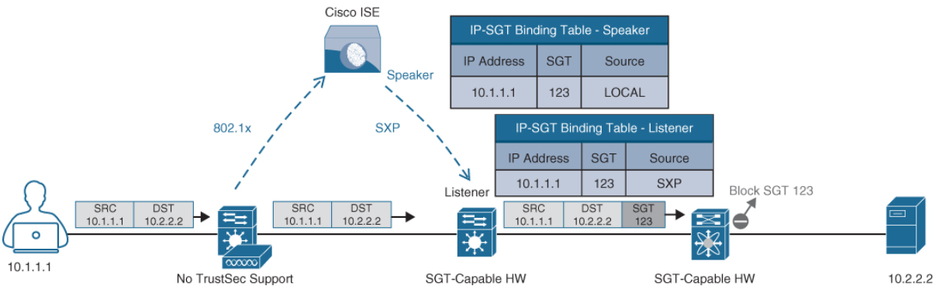
Network Access Control (NAC) Egress Enforcement
After the SGT tags have been assigned (classification) and are being transmitted across the network (propagation), policies can be enforced at the egress point of the TrustSec network.
There are multiple ways to enforce traffic based on the SGT tag, and they can be divided into two major types:
Security Group ACL (SGACL) - Provides enforcement on routers and switches. Access lists provide filtering based on source and destination SGT tags.
Security Group Firewall (SGFW) - Provides enforcement on firewalls (such as Cisco ASA and NGFW). Requires tag-based rules to be defined locally on the firewall.
Figure 25-14 TrustSec
Enforcement with SGACL

Slide 56
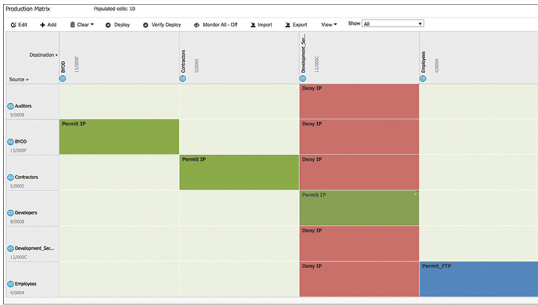
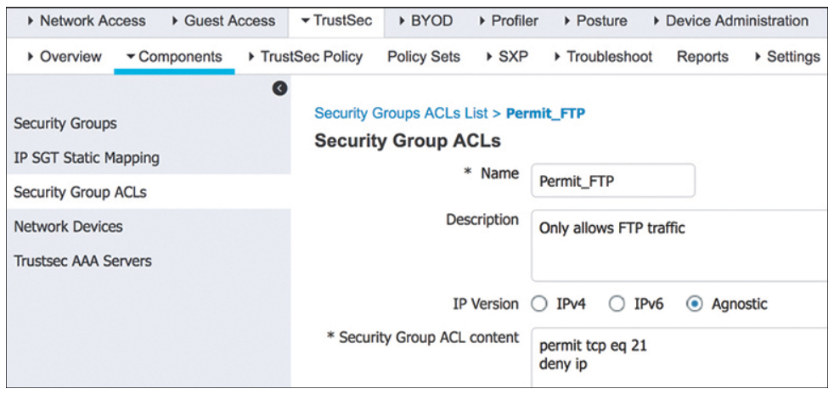
Network Access Control (NAC) Egress Enforcement: SGACL
Figure 25-15 illustrates an SGACL egress policy production matrix from Cisco ISE that allows the defined SGACL enforcements to be visualized.
Figure 25-16 shows the SGACL Permit_FTP configuration on Cisco ISE, which is only allowing FTP traffic (TCP port 21) and denying all other traffic.
Figure 25-15 SGACL Production Matrix View
Figure 25-16 Permit FTP SGACL Contents

Slide 57
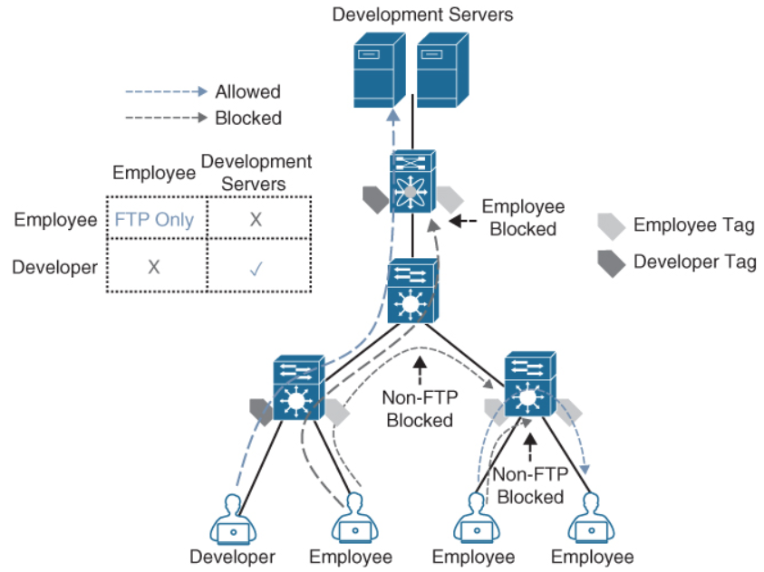
Network Access Control (NAC) Egress Enforcement Example
Figure 25-17 illustrates a scenario where only developers have access to the development servers, and any employee trying to access them is blocked.
Traffic is blocked on egress and not on ingress.
This example also illustrates that FTP is the only protocol allowed between employees, while any other type of traffic is blocked. For the employees connected to the same switch, the switch is acting as the ingress and egress point.
Figure 25-17 SGACL Enforcement Scenario

Slide 58
Network Access Control (NAC) MACsec
MACsec is an IEEE 802.1AE standards-based Layer 2 hop-by-hop encryption method.
The traffic is encrypted only on the wire between two MACsec peers and is unencrypted as it is processed internally within the switch. This allows the switch to look into the inner packets for things like SGT tags to perform packet enforcement or QoS prioritization.
MACsec also leverages onboard ASICs to perform the encryption and decryption rather than having to offload to a crypto engine, as with IPsec.
MACsec is based on the Ethernet frame format; however, an additional 16-byte MACsec Security Tag field (802.1AE header) and a 16-byte Integrity Check Value (ICV) field are added.
MACsec provides authentication using Galois Method Authentication Code (GMAC) or authenticated encryption using Galois/Counter Mode Advanced Encryption Standard (AES-GCM).

Slide 59
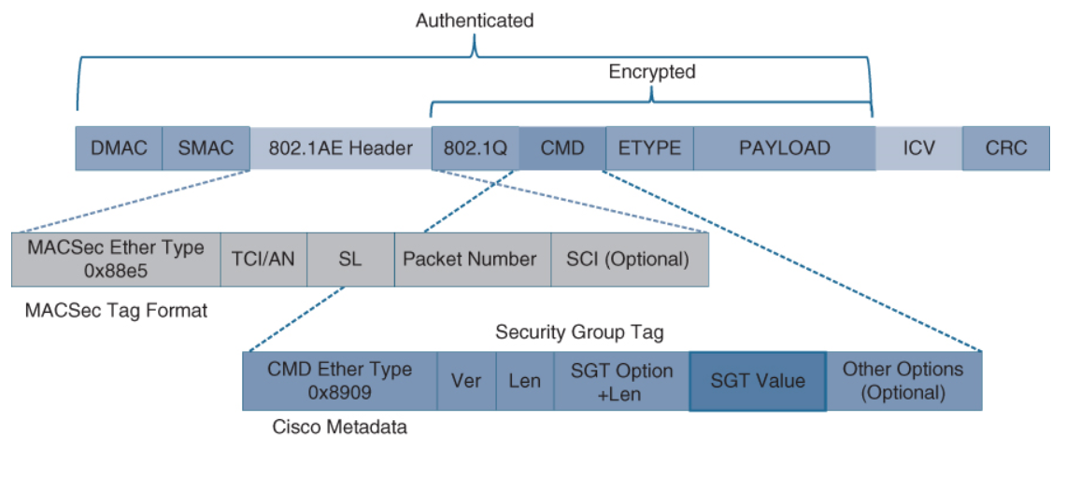
Network Access Control (NAC) MACsec Illustrated
Figure 25-18 illustrates the MACsec frame format and how it encrypts the TrustSec SGT tag.
Figure 25-18 MACsec Ethernet Frame with SGT

Slide 60
Network Access Control (NAC) MACsec Tags
The MACsec Security Tag fields are as follows:
MACsec EtherType (first two octets) - Set to 0x88e5, designating the frame as a MACsec frame
TCI/AN (third octet) - Tag Control Information/Association Number field, designating the version number if confidentiality or integrity is used on its own
SL (fourth octet) - Short Length field, designating the length of the encrypted data
Packet Number (octets 5–8) - The packet number for replay protection and building of the initialization vector
SCI (octets 9–16) - Secure Channel Identifier, for classifying the connection to the virtual port
Two MACsec keying mechanisms are available:
Security Association Protocol (SAP) - This is a proprietary Cisco keying protocol used between Cisco switches.
MACsec Key Agreement (MKA) protocol - MKA provides the required session keys and manages the required encryption keys.

Slide 61
Network Access Control (NAC) Downlink MACsec
Downlink MACsec is the term used to describe the encrypted link between an endpoint and a switch.
The encryption between the endpoint and the switch is handled by the MKA keying protocol. This requires a MACsec-capable switch and a MACsec-capable supplicant on the endpoint (such as Cisco AnyConnect). The encryption on the endpoint may be handled in hardware or in software, using the main CPU for encryption and decryption.
The Cisco switch has the ability to force encryption, make encryption optional, or force non-encryption.
This setting may be configured manually per port (which is not very common) or dynamically as an authorization option from Cisco ISE.
If ISE returns an encryption policy with the authorization result, the policy issued by ISE overrides anything set using the switch CLI.

Slide 62
Network Access Control (NAC) Uplink MACsec
Uplink MACsec is the term for encrypting a link between switches with 802.1AE.
By default, uplink MACsec uses Cisco proprietary SAP encryption. The encryption is the same AES-GCM-128 encryption used with both uplink and downlink MACsec.
Uplink MACsec may be achieved manually or dynamically. Dynamic MACsec requires 802.1x authentication between the switches.

Slide 63
Prepare for the Exam

Slide 64
Prepare for the Exam Key Topics for Chapter 25
Description
Cisco SAFE places in the network (PINs) | Cisco Web Security Appliance (WSA)
Full attack continuum | Cisco Email Security Appliance (ESA)
Cisco Talos | Intrusion Prevention System (IPS)
Cisco Threat Grid | Next-Generation Intrusion Prevention System (NGIPS)
Cisco Advanced Malware Protection (AMP) | Standard Firewall
Cisco AMP components | Next-Generation Firewall (NGFW)
Cisco AnyConnect | Cisco Stealthwatch
Cisco Umbrella

Slide 65
Prepare for the Exam Key Topics for Chapter 25 (Cont.)
Description
Cisco Stealthwatch Offerings | Web Authentication (WebAuth)
Cisco Stealthwatch Required Components | WebAuth Types
Cisco Stealthwatch Cloud Offerings | Cisco TrustSec
Cisco Identity Services Engine (ISE) | Cisco TrustSec Phases
802.1x | Cisco TrustSec Propogation Methods
802.1x Components | Cisco TrustSec Types of Enforcement
802.1x Roles | MACsec
EAP Methods | MACsec Keying Mechanism
EAP Chaining | Downlink MACsec
MAC Authentication Bypass (MAB) | Uplink MACsec

Slide 66
Prepare for the Exam Key Terms for Chapter 25
Terms
802.1x | Cisco TrustSec
Cisco Advanced Malware Protection (AMP) | Cisco Umbrella
Cisco AnyConnect Secure Mobility Client | Cisco Web Security Appliance (WSA)
Cisco Email Security Appliance (ESA) | Endpoint
Cisco Identity Services Engine (ISE) | Extensible Authentication Protocol (EAP)
Cisco SAFE | MAC Authentication Bypass (MAB)
Cisco Stealthwatch | MACsec
Cisco Talos | next-generation firewall(NGFW)
Cisco Threat Grid | Web Authentication (WebAuth)

